Slide 1
Data Mining Tasks
-Presented By:
SHAWNI DUTTA

Slide 2
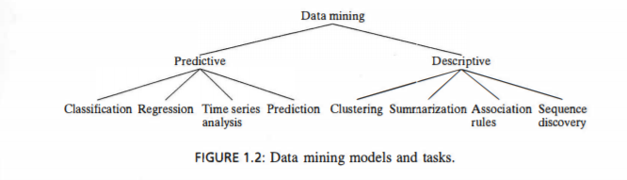
Data Mining Tasks
Data Mining tasks may be broadly categorized into two types:
Predictive Tasks.
Descriptive Tasks.

Slide 3
Predictive Tasks
Objective: To predict the value of particular attribute based on the values of other attributes.
Target/Dependent variable: Attribute to be predicted.
Explanatory/Independent variable: Attributes used for prediction.
A predictive model makes a prediction about values of data using known results found from different data. Predictive modeling may be made based on the use of other historical data.
For example, a credit card use might be refused not because of the user's own credit history, but because the current purchase is similar to earlier purchases that were subsequently found to be made with stolen cards.
Predictive model data mining tasks include classification, regression, time series analysis, and prediction. Prediction may also be used to indicate a specific type of data mining function.

Slide 4
Descriptive Tasks
Objective: To derive patterns that summarizes the underlying relationships in the data. The value of particular attribute based on the values of other attributes.
Unlike the predictive model, a descriptive model serves as a way to explore the properties of the data examined, not to predict new properties. Clustering, summarization, association rules, and sequence discovery are usually viewed as descriptive in nature.

Slide 5
Classification
Classification maps data into predefined groups or classes. It is often referred to as supervised learning because the classes are determined before examining the data.
Two examples of classification applications are determining whether to make a bank loan and identifying credit risks.
Classification algorithms require that the classes be defined based on data attribute values. They often describe these classes by looking at the characteristics of data already known to belong to the classes.
Pattern recognition is a type of classification where an input pattern is classified into one of several classes based on its similarity to these predefined classes.
An airport security screening station is used to determine: if passengers are potential terrorists or criminals. To do this, the face of each passenger is scanned and its basic pattern (distance between eyes, size and shape of mouth, shape of head, etc.) is identified. This pattern is compared to entries in a database to see if it matches any patterns that are associated with known offenders.

Slide 6
Regression
Regression is used to map a data item to a real valued prediction variable. In actuality, regression involves the learning of the function that does this mapping.
Regression assumes that the target data fit into some known type of function (e.g., linear, logistic, etc.) and then determines the best function of this type that models the given data.

Slide 7
Regression : Example
A college professor wishes to reach a certain level of savings before her retirement. Periodically, she predicts what her retirement savings will be based on Its current value and several past values.
She uses a simple linear regression formula to predict this value by fitting past behavior to a linear function and then using this function to predict the values at points in the future. Based on these values, she then alters her investment portfolio.

Slide 8
Time Series Analysis
With time series analysis, the value of an attribute is examined as it varies over time. The values usually are obtained as evenly spaced time points (daily, weekly, hourly, etc.)

Slide 9
Prediction
Prediction can be viewed as a type of classification.
The difference is that prediction is predicting a future state rather than a current state.

Slide 10
Clustering
Clustering is similar to classification except that the groups are not predefined, but rather defined by the data alone.
Clustering is alternatively referred to as unsupervised learning or segmentation.
It can be thought of as partitioning or segmenting the data into groups that might or might not be disjointed.

Slide 11
Clustering: Example
A certain national department store chain creates special catalogs targeted to various demographic groups based on attributes such as income, location, and physical characteristics of potential customers (age, height, weight, etc.).
To determine the target mailings of the various catalogs and to assist in the creation of new, more specific catalogs, the company performs a clustering of potential customers based on the determined attribute values. The results of the clustering exercise are then used by management to create special catalogs and distribute them to the correct target population based on the cluster for that catalog.

Slide 12
Summarization
Summarization maps data into subsets with associated simple descriptions.
Summarization is also called characterization or generalization.
It extracts or derives representative information about the database.

Slide 13
Summarization: Example
One of the many criteria used to compare universities by the U.S. News & World Report is the average SAT or AC T score [GM99]. This is a summarization used to estimate the type and intellectual level of the student body.

Slide 14
Association Rules
Link analysis, alternatively referred to as affinity analysis or association, refers to the data mining task of uncovering relationships among data.
The best example of this type of application is to determine association rules.
An association rule is a model that identifies specific types of data associations.
These associations are often used in the retail sales community to identify items that are frequently purchased together.

Slide 15
Association Rules : Example
A grocery store retailer is trying to decide whether to put bread on sale. To help determine the impact of this decision, the retailer generates association rules that show what other products are frequently purchased with bread. He finds that 60% of the time that bread is sold so are pretzels and that 70% of the time jelly is also sold.
Based on these facts, he tries to capitalize on the association between bread, pretzels, and jelly by placing some pretzels and jelly at the end of the aisle where the bread is placed. In addition, he decides not to place either of these items on sale at the same time.

Slide 16
Sequence Discovery
Sequential analysis or sequence discovery is used to determine sequential patterns in data. These patterns are based on a time sequence of actions. These patterns are similar to associations in that data (or events) are found to be related, but the relationship is based on time.
Unlike a market basket analysis, which requires the items to be purchased at the same time, in sequence discovery the items are purchased over time in some order.

Slide 17
Sequence Discovery
Sequential analysis or sequence discovery is used to determine sequential patterns in data. These patterns are based on a time sequence of actions. These patterns are similar to associations in that data (or events) are found to be related, but the relationship is based on time.
Unlike a market basket analysis, which requires the items to be purchased at the same time, in sequence discovery the items are purchased over time in some order.
For example, most people who purchase CD players may be found to purchase CDs within one week.

Slide 18
DATA MINING VERSUS KNOWLEDGE DISCOVERY IN DATABASES
DEFINITION 1.1. Knowledge discovery in databases (KDD) is the process of finding useful information and patterns in data.
DEFINITION 1.2. Data mining is the use of algorithms to extract the information and patterns derived by the KDD process.

Slide 19
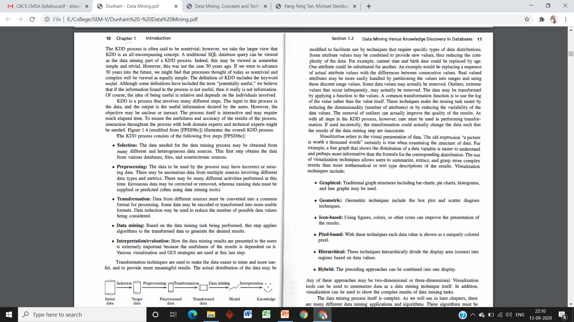
DATA MINING VERSUS KNOWLEDGE DISCOVERY IN DATABASES

